Slide 1
STANDARD C LIBRARY INPUT AND OUTPUT FUNCTIONS
PRESENTED BY
HARIKRISHNA LAKA

Slide 2
CONTENTS
ABOUT HEADER FILES
INTRODUCTION TO LIBRARY’S AND FUNCTION’S
FLOW OF EXECUTION OF PRINTF() AND SCANF()
CONVERTION SPECIFICATIONS
READING INPUT DATA
WRITTING OUTPUT DATA
FORMATTED INPUT AND OUTPUT
REFERENCES

Slide 3
ABOUT HEADER FILES
Header Files are added in Preprocessing stage (first stage)of compilation.
It contains C declarations, Macro definition’s , description of header files to be shared between several header files.
In that #include directive read by the preprocessor and insert content of user defined/system header files data.
It is a source file has the .h extension, It contains Function protypes(or)Declarations.
And these are verified in Second stage of Compilation.
When we’re using Other library function in our program we must link that library during compilation time , Other wise it display linking error.
We must include corresponding header files in our C programe for compiler verification purpose, By getting and knows from the manual pages.
If you don’t mention the <stdio. h> header file section it gives output, Because ‘C’ library’s known’s the Standard C library’s.

Slide 4
INTRODUCTION TO LIBRARY’S AND FUNCTION’S
FUNCTION :
It is defined as a set of instructions to perform a particular task are called
“Function”.
Functions names should be a meaning full names.
A program logic can be sub-divided into multiple tasks each task defines a function.
In general any function takes inputs as arguments.so ,that function will process the data based on inputs finally generates required output.
The number of input’s are separated by a comma operator.
AGAIN FUNCTION’S ARE TWO TYPE’S
Pre-defined Functions.
User-defined Functions.
In general any Function will have Function Declaration , Defination and invocation.
For User defined Function’s We can see declaration’s , defination’ s and Function invocation with in the same C program.
For Predefined function declarations are present in header file, defination’s are present in Library’s and Invokation’s are in the C program.

Slide 5
LIBRARY’S
Every library function’s internally invokes one system calls , Each system call will have an equivalent kernel call identified by a unique positive number.
Static:
Happens as the last step of the compilation process. After the program is placed in the memory.
It is created with <libname.a> extention.
Dynamic:
Shared libraries are added during linking process when executable file and libraries are added to the memory.
It is created with <libname.so> extention.

Slide 6
FLOW OF EXECUTION OF PRINTF() AND SCANF()
FLOW OF EXECUTION OF PRINTF()
Printf(): It is used to display the data on terminal screen in the User spacefied format.
DECLARATION OF PRITF()
Int printf(const char *src,…);
To this printf() we can pass single /multiple inputs.
Printf() always first input is a string constant , and this string constant is the combination of that is the string which that we display as its and plus formate specifier , Field width , Separators, Executable characters.
Eg: Int x=10;
printf(“%d\n”,x);

Slide 7
To separate the output we can use separators are executable character’s.
The separators are any character or symbol.
Can not be used as a % conversion specifier as a separator.
Eg: int x=2;
printf(“%d-%x-%o”, x , x , x);
Printf() will evaluate from right to left and prints left to right.
Printf() will returns the count no.of character’s displayed on the terminal screen.
Printf() will stop the printing the data until the null character ‘\0’
Eg: printf(“Wel\0come\n”);
In that base address will passed in that .rodata formate.

Slide 8
Flow OF Execution of printf()

Slide 9
SCANF():
It is a standard C library input function, generally it behaves as a blocking call that means the execution of the programe will suspended until the user enters the input[ Read inputs at run time only].
DECLARATION:
Int scanf(const char *src,…);
Scanf() in that 1st input is string constant ,the string constant it is the combination of format specifiers along separators.
From second input onwards we’ve to pass memory location address only.
Scanf() always deals with memory location address . The number of formate specifiers mention in 1st input should be equal to number of memory location address from 2nd input onwards.
Always scanf followed by printf().

Slide 10
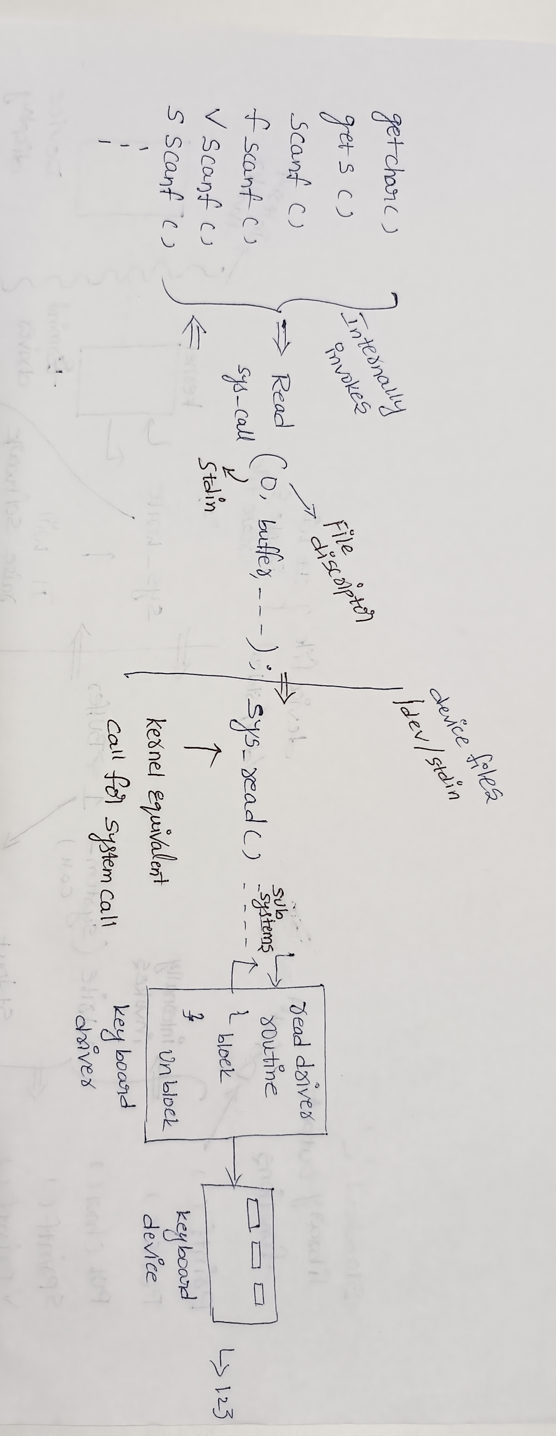
Flow of execution of scanf( )

Slide 11
CONVERTION SPECIFICATIONS
FORMATE SPECIFIERS
The Functions scanf() and printf() make use of conversion specifications to specify the type and size of data. Each conversion specification must begin with a percent sign (%).
Conversion Character Meaning
%c - print binary to Ascii values
%d - print binary to signed decimal
%u - print binary to unsigned int
%i - print binary to decimal values
%x - print binary to hexa decimal values
%o - print binary to octal values
%F 0r %f - print binary to float
%E or %e - print binary to exponentional
%G or %g - print binary to float or exponentional
%s - print starting base address
%p - print address in hexa decimal formate

Slide 12
EXECUTABLE CHARACTERS WITH CHANGING CURSOR POSITION
Executable characters are non – printable characters simply they changes the cursor positions these executables characters along with field width . We can display the output in a particular formate .
\b - backspace cursor will jump one previous position
\t - Horizontal tab we can see 8 empty spaces
\v - vertical tab cursor will jump from current to next line same position
\a - aleart gives a beep/bell sound
Eg: #include<stdio.h>
Int main()
{
int ret; OUTPUT: welcome
ret=printf(“welcome\n”); hi
Printf(“hi \t \v hello \b child\n”); hello child
}

Slide 13
FIELD WIDTH
It will reserved the number of empty spaces for the given output , the output will not change.
The field width can be a positive or negative number are even it can be a real constant . It must be used along with the format specifier.
Positive field width will justify the output towards the right hand side, negative field width will justify output towards output left hand side.
Eg:1 printf(“%-10d%-10d\n”,123,12345);
Output: 123-------
12345-----

Slide 14
READING INPUT DATA(scanf())
Input data can be entered into the memory from a standard input device. The scanf() library function can be used for entering data.This function can take all types of values as input.
Scanf(“control string”,address1,address2,….);
This function should have atleast two parameters. First control string in double quotes, The conversion specification characters may be one or more, it depends on the number of variables we want to input. The other parameters are address of variables.
Eg:1 #include<stdio.h>
int main(void){ output: The control string contains only one
int marks; conversion specifier %d, i.e. one integer
-------- value should be entered as input.
scanf(“%d”, &marks);
--------
}

Slide 15
Eg2: #include<stdio.h>
int main(void){ output: Here control string contain
char ch; conversion specification character %c,
----------- , that a single character should be
scanf(“%c”,&ch); entered as input.in variable ch .
----------
}
Eg:3 #include<stdio.h>
int main(){ output: Here control string contains
char str[10]; conversion specifier as %s and not
--------------- preceded by ampersand(&)sign.
scanf(“%s”, str);
-----------------
}

Slide 16
Eg:4
#include<stdio.h> output: Here 17 is stored in variable day, 6 in
int main(void){ month and 2001 year stored in va
int day , month , year; and 3000 stored in variable basic.
int basic; -> If you give any spaces inside string they
--------------- just ignored.
scanf(“%d-%d-%d”, &day ,&month, &year);
scanf(“$%d”, & basic);
------------------
}

Slide 17
DELIMITERS USAGES:
when more than one values are input by scanf(), these values ca be separated by Whitespace characters like space, tab or new line. A specific character can also be placed between two conversion specification character as a delimiter.
Eg:3 #include<stdio.h>
int main(void){
int age;
float marks;
------------------
scanf(“%d:%f”, &age, &marks);
------------------------- }

Slide 18
WRITING OUTPUT DATA
Output data can be written from computer memory to the standard output device using printf() library function.
Printf(“control string”,variable1,variable2,…);
The names of variables should not be preceded by an (&)sign .If control string does not contain any conversion specification, the variable names are not specified.
Eg:1#include<stdio.h>
int main(){ output: Here only text no conversion
printf(“C is excellent\n”); specification characters , so output only
return 0; text.
}

Slide 19
FORMATTED INPUT AND OUTPUT
Data can be entered and displayed in a particular format. Through format specifications, better presentation of result can be obtained . Formats for different specifications are as..
FORMATTED FOR INTEGER INPUT
%wd => d is conversion specifier, w is an integer number specifying maximum field width of input data.
If length of input more than this maximum field width then the values not stored correctly.
Scanf(“%2d%3d”,&a , & b);
When I/P data length less than or equal to given field width, the input values are unaltered and stored in variables.

Slide 20
FORMATTED OUTPUT
%wd=> w is integer number specifying the field width of the output data. If length of variable is then specified field width ,the variable is right justified with leading blanks.
Printf(“a=%3d,b=%4d”,a,b);
When input length less than or equal to given field width ,input values are not change and stored in given variables.
Eg: int a=6,b=394; //6 stored in a varible,394 stored in b variable
When input data length more than given field width than input values changed and stored in the variables.
Eg: 269 3845
26 stored in a variable,9 stored in b , rest of the values are ignored.
FOR INTEGER OUTPUT:
If length of a variable less than the specified field width, The variable right justified with leading blanks
Eg: printf(“%3d%4d”,a,b);
Length of variable less than width specifier .//Eg: 78 92
a | = |  | 7 | 8 | , | b | = |  |  | 9 | 2

Slide 21
FORMAT FOR FLOATING POINT NUMRIC INPUT
%Wf =>Here W is Integer numeric specifier the total length of data.
Scanf(“%3f%4f”,&x,&y);
When I/P length less than or equal to given width, values are not change.
Eg: 5 5.93 // Both are stored as useually.
FORMAT FOR STRING INPUT
%Ws => Here W specifies total number of characters that will stored in string.
Eg: char str [8]; // str: welcome
Scanf(“%3s”,str); // ‘w’, ’e’, ‘l’, ‘\0’
SUPPRESSION CHARACTER IN SCANF()
If you want to skip any input field , we can specify * between the % sign and the conversion specification.

Slide 22
The character * called Suppression character.
Eg: scanf(“%d%*c%d%8c%d”,&d,&m,&y);
INPUT: 7/11/2001
7 ,11,2001 will be stored accordingly respective spaces.
CHARACTER I/O
getchar () and put char():
These functions can be used for character I/O.
getchar () reads a single character from the standard input.
Putchar () outputs one character at a time to the standard output.

Slide 23
Eg:
int main(void)
{
char ch;
printf(“Enter a char:\n”);
ch=getchar ();
printf(“The entered char is:\n”);
putchar(ch);
return 0;
}
Output:
Enter a char: B
The entered char is B

Slide 24
THANK YOU

